Slide 1
Night light
By me

Slide 2
Research
A night-light
This will help people to see where they are going at night

Slide 3
design

Slide 4


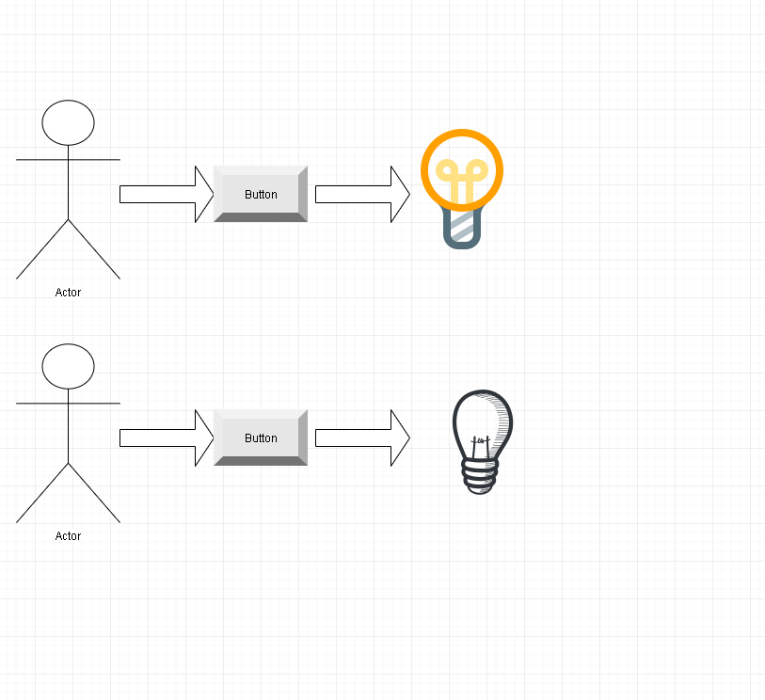
design - Option 1
The idea:
Activated by a push of a button
Deactivated by a push of a button

Slide 5
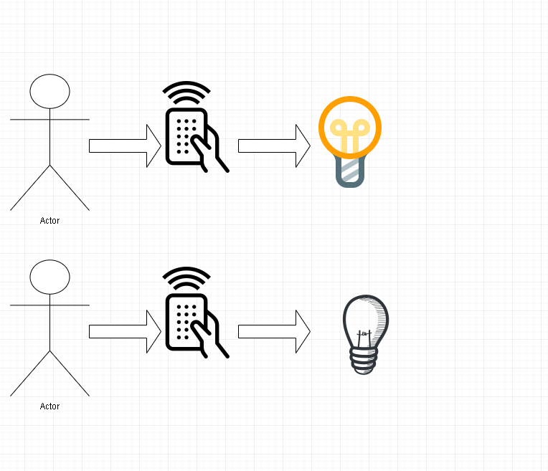
design - Option 2
The idea:
Activated by a remote controller (RC)
Deactivated by a RC

Slide 6
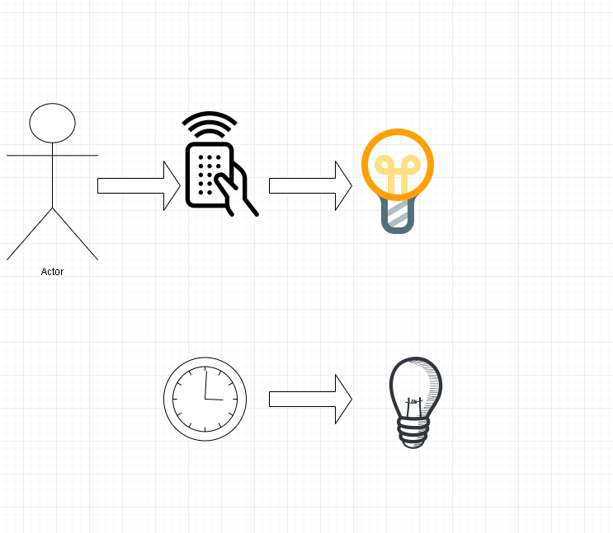
design - Option 3
The idea:
Activated by a RC
Deactivated automatically by a countdown timer
Final option and the option I choose to make

Slide 7
Construct

Slide 8
Construct -

